Slide 1
5COSC020W DATABASE SYSTEMS – LECTURE 02
Conceptual Database Design – Enhanced Entity-Relationship Modelling

Slide 2
Lecture 02 – Outline
Conceptual Design for Relational Databases: complex relationships
Ternary and quaternary relationships.
Recursive relationships.
Multiple relationships between entities.
Enhanced Conceptual Design for Relational Databases: generalisations
Enhanced Conceptual Entity-Relationship Modelling and EERDs.
Generalisation/specialisation.
Attribute inheritance and relationship inheritance.
Constraints on generalisations/specialisations.
Redundant Relationships.
Data Dictionary.

Slide 3
Phases and outputs of Database Design (recap)
Data Requirements
BUSINESS USER’S DATA NEEDS
to support business processes
☑
CONCEPTUAL DESIGN
CONCEPTUAL DATA MODEL OR CONCEPTUAL SCHEMA
of the data required by business users
☑
LOGICAL DESIGN (Mapping)
LOGICAL DATA MODEL OR LOGICAL SCHEMA
based on specific file data organisation (e.g. relational model)

PHYSICAL DESIGN
PHYSICAL OR INTERNAL SCHEMA
storage structures, file organizations, indexes, access paths
☑
DATABASE IMPLEMENTATION & QUERYING
DATABASE IMPLEMENTED & QUERIED IN DBMS
data structures, constraints, data values, data description

Slide 4
Step-by-step approach to Conceptual Design (recap)
Identity ENTITIES
Objects or things with independent existence on which data needs to be stored.
Identify RELATIONSHIPS
Meaningful associations between occurrences of entities.
Identify ATTRIBUTES
Properties of Entities (and sometimes of Relationships) that capture data values.
Identify PRIMARY KEYS (PKS)
Attribute that is a unique identifier, irreducible and selected.
Consider enhanced modelling concepts e.g. specialisations/generalisations
Check and remove redundancies

Slide 5
Example of a binary relationship with multiplicities (recap)
Branch
has
Staff
0..1
0..*
ONE Branch may have NO Staff assigned to it (Participation is 0)
A branch may be brand new (not staffed yet) or underperforming (cleared out).
ONE Branch may have MANY Staff assigned to it (Cardinality is *)
A branch will typically have many staff allocated to work at that specific branch.
ONE Staff may NOT BE ASSIGNED TO ANY Branch (Participation is 0)
A staff may be working outside the branch system e.g. Director, Driver, IT support.
ONE Staff must be assigned to UP TO ONE Branch (Cardinality is 1)
The structure of the firm says that staff can only be given one branch, no more.

Slide 6
Degree of a relationship
Degree of a relationship: number of participating entities
Binary relationship: relationship between 2 entities (most common).
Ternary relationship: relationship between 3 entities.
Quaternary relationship: relationship between 4 entities.
N-nary relationship: relationship between n entities.

Slide 7

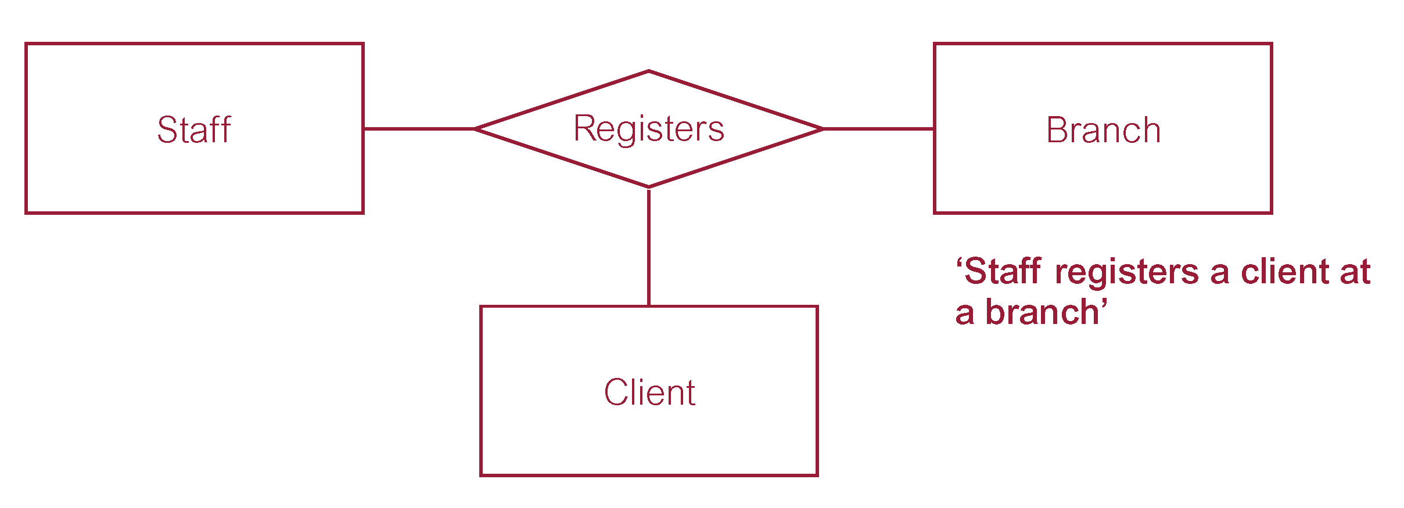
Binary and ternary relationships
Binary Relationship
1..1
1..*
Ternary Relationship
1..1
1..1
1..*

Slide 8
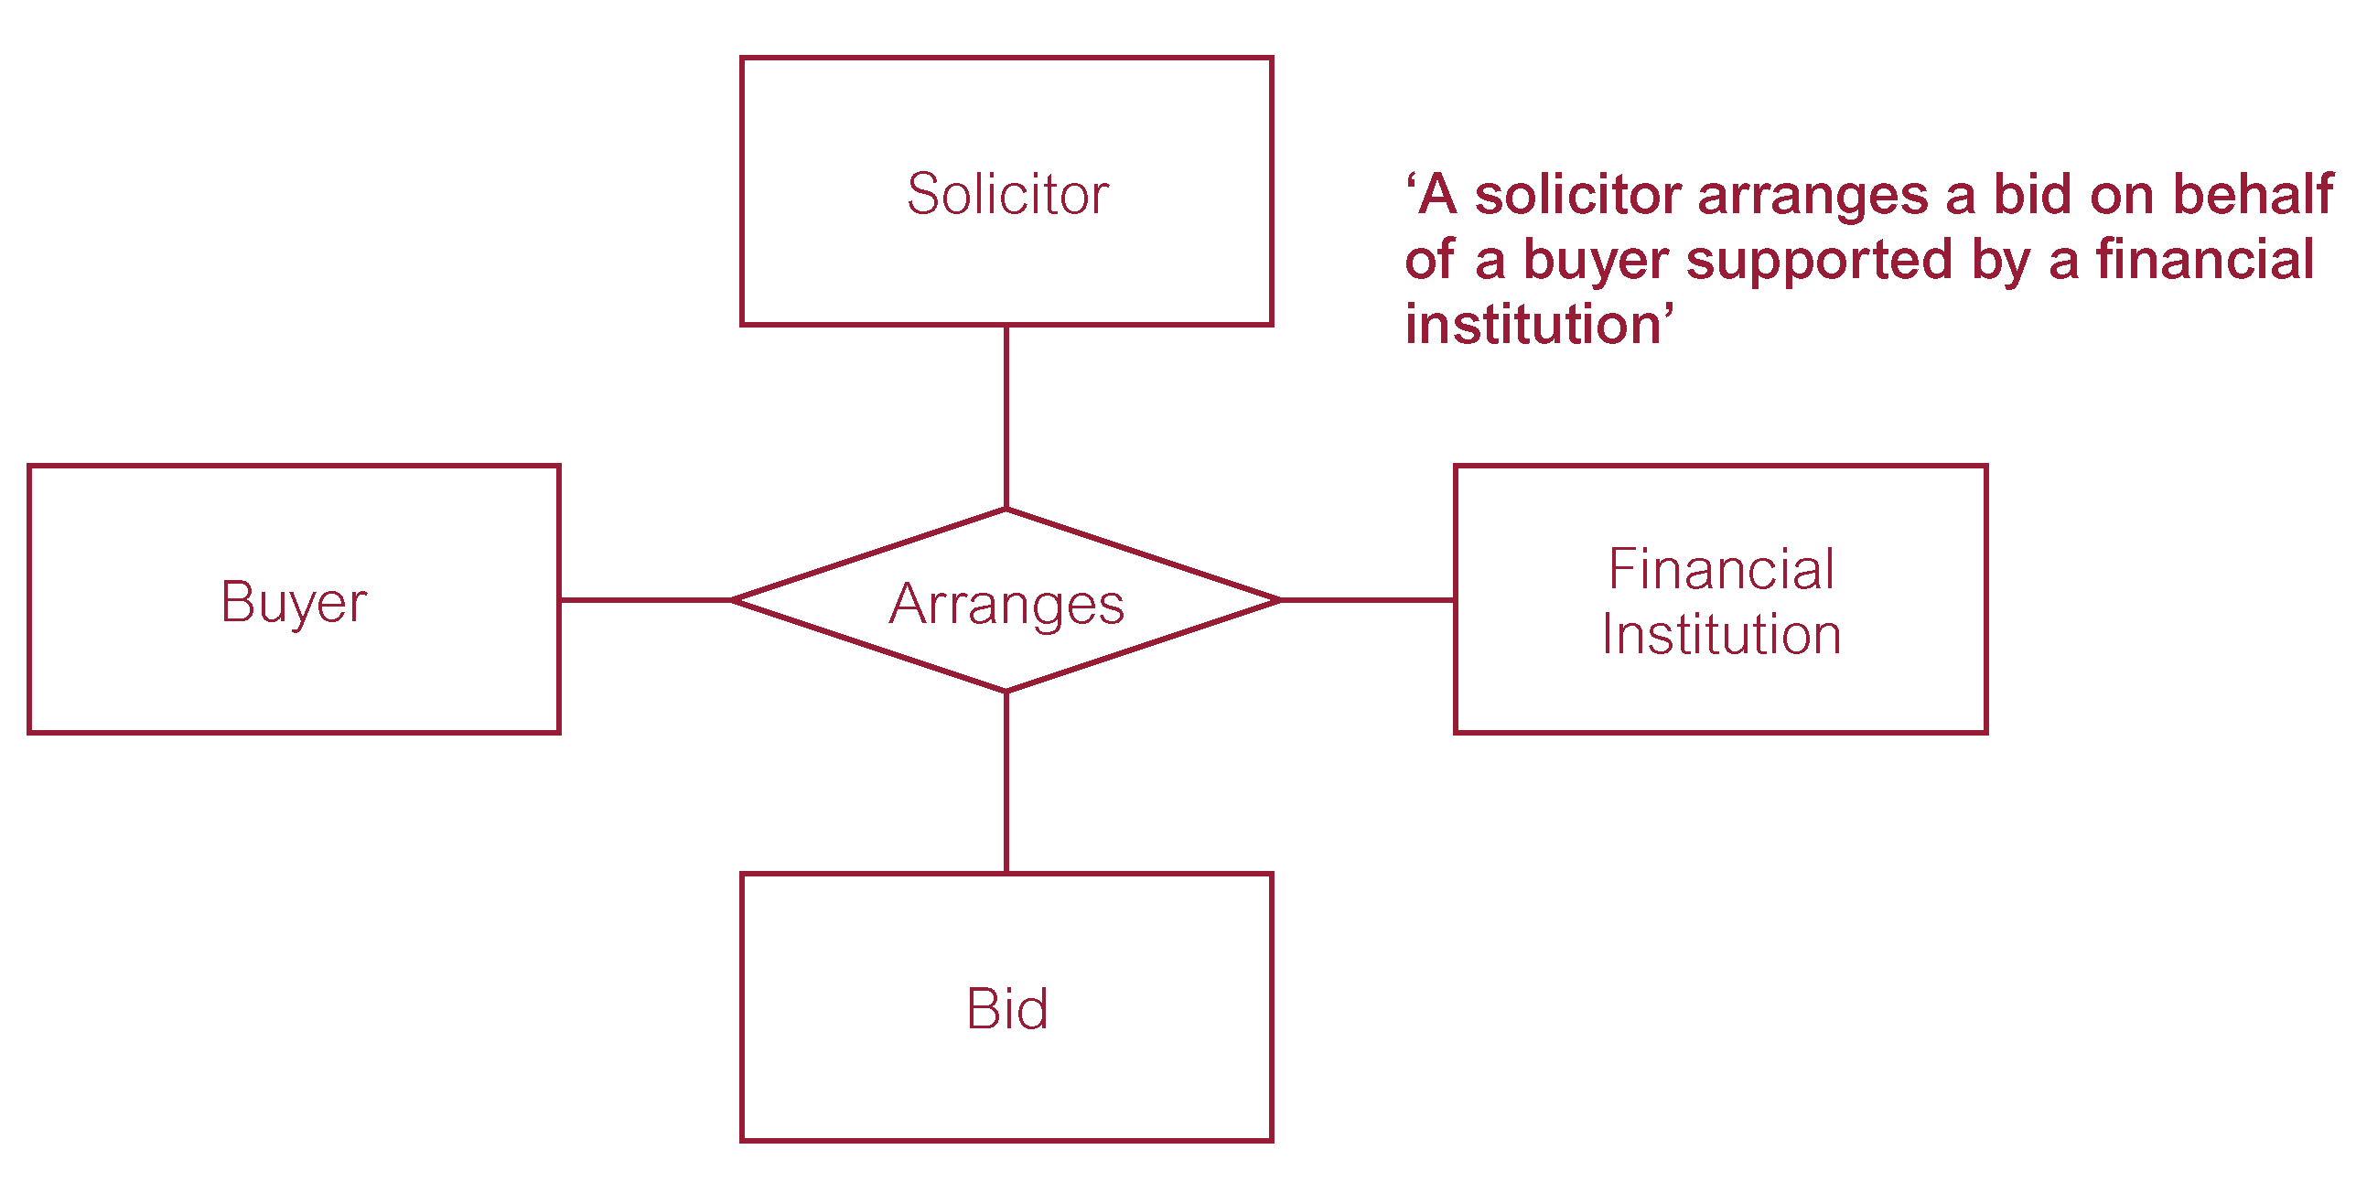
Quaternary relationships
Quaternary relationship
1..1
1..1
1..1
1..*

Slide 9
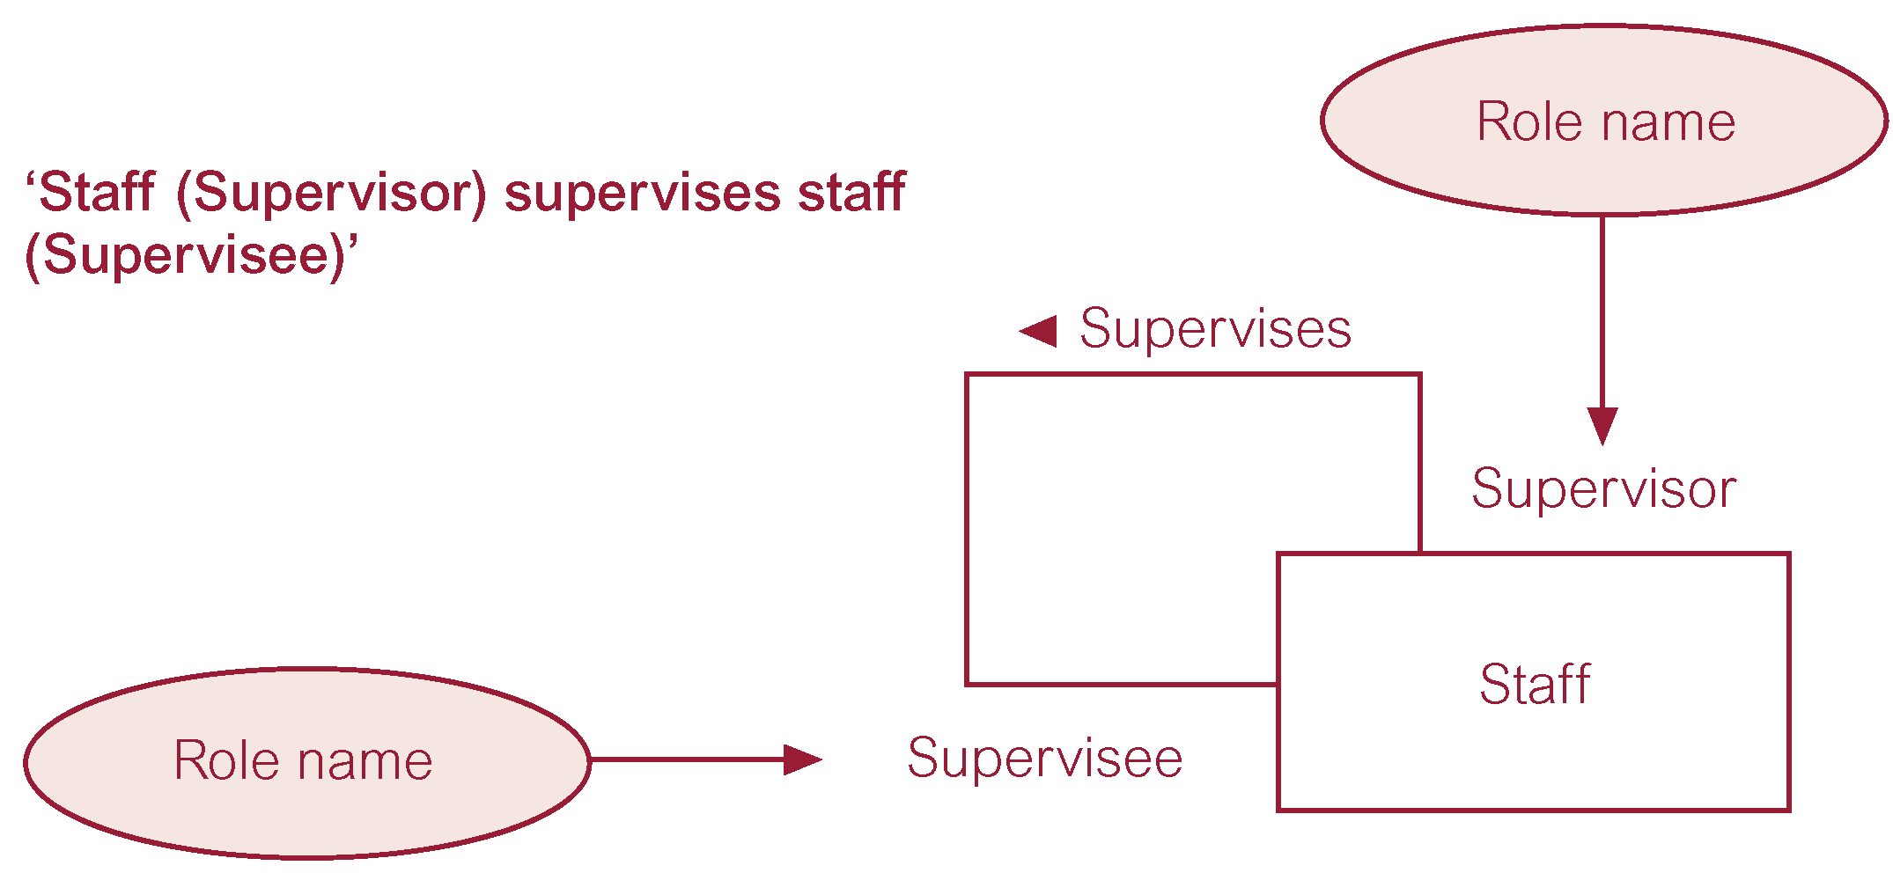
Recursive relationships
Recursive Relationship
Same entity participates more than once in relationship with different roles.
Name roles to indicate roles played by each participating entity in relationship.
0..1
0..*

Slide 10
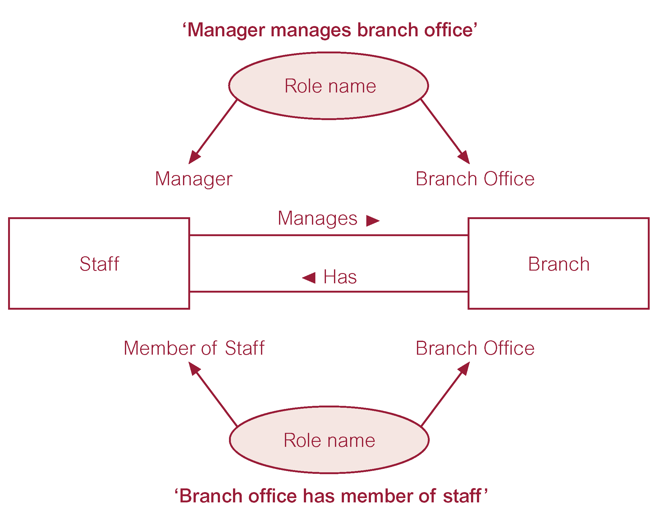
Multiple relationships between entities (1)
Multiple Relationships
Occurrences of an entity associated to occurrences of another entity through more than one relationship.
Name roles to indicate roles played by each participating entity in relationship.
1..1
0..1
0..*
0..1

Slide 11
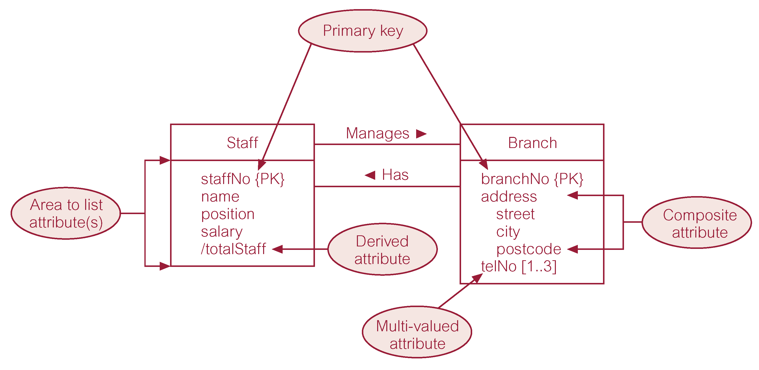
Multiple relationships between entities (2)
1..1
0..1
0..*
0..1

Slide 12
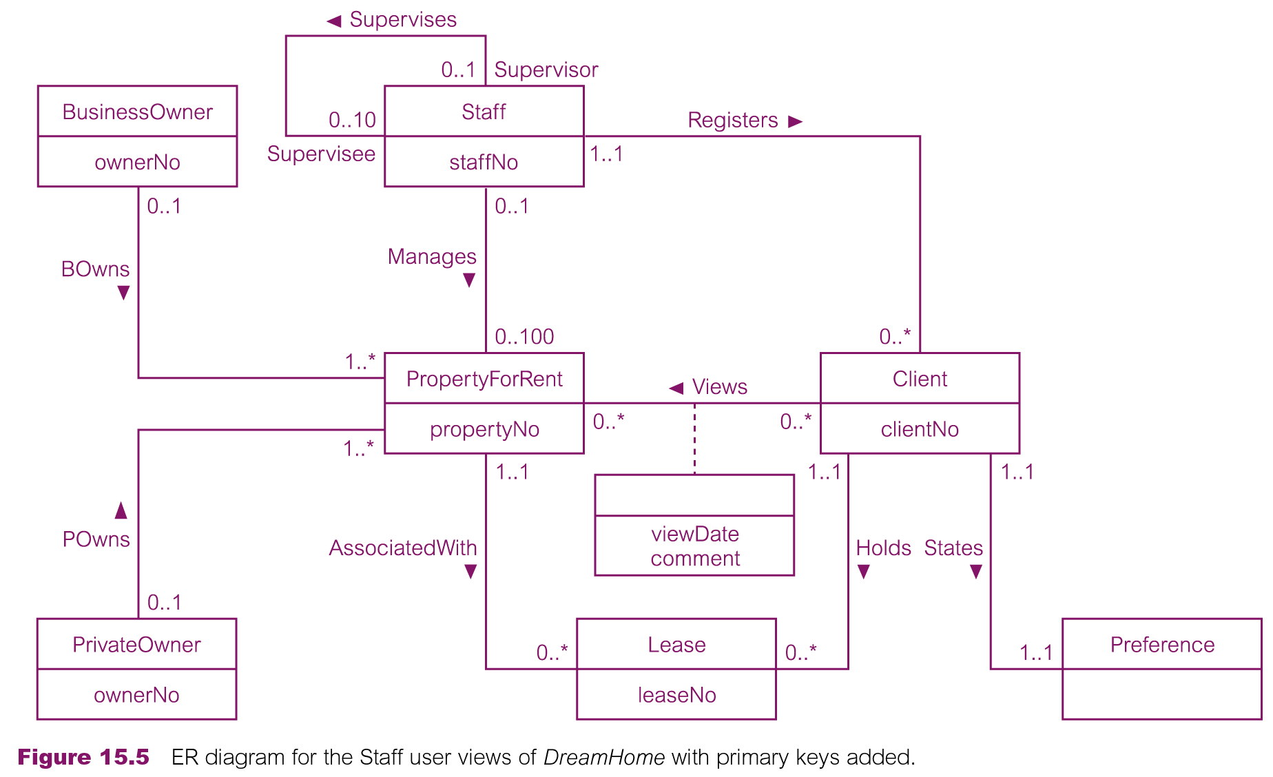
DREAMHOME Conceptual ERD (Staff View with PKs)

Slide 13
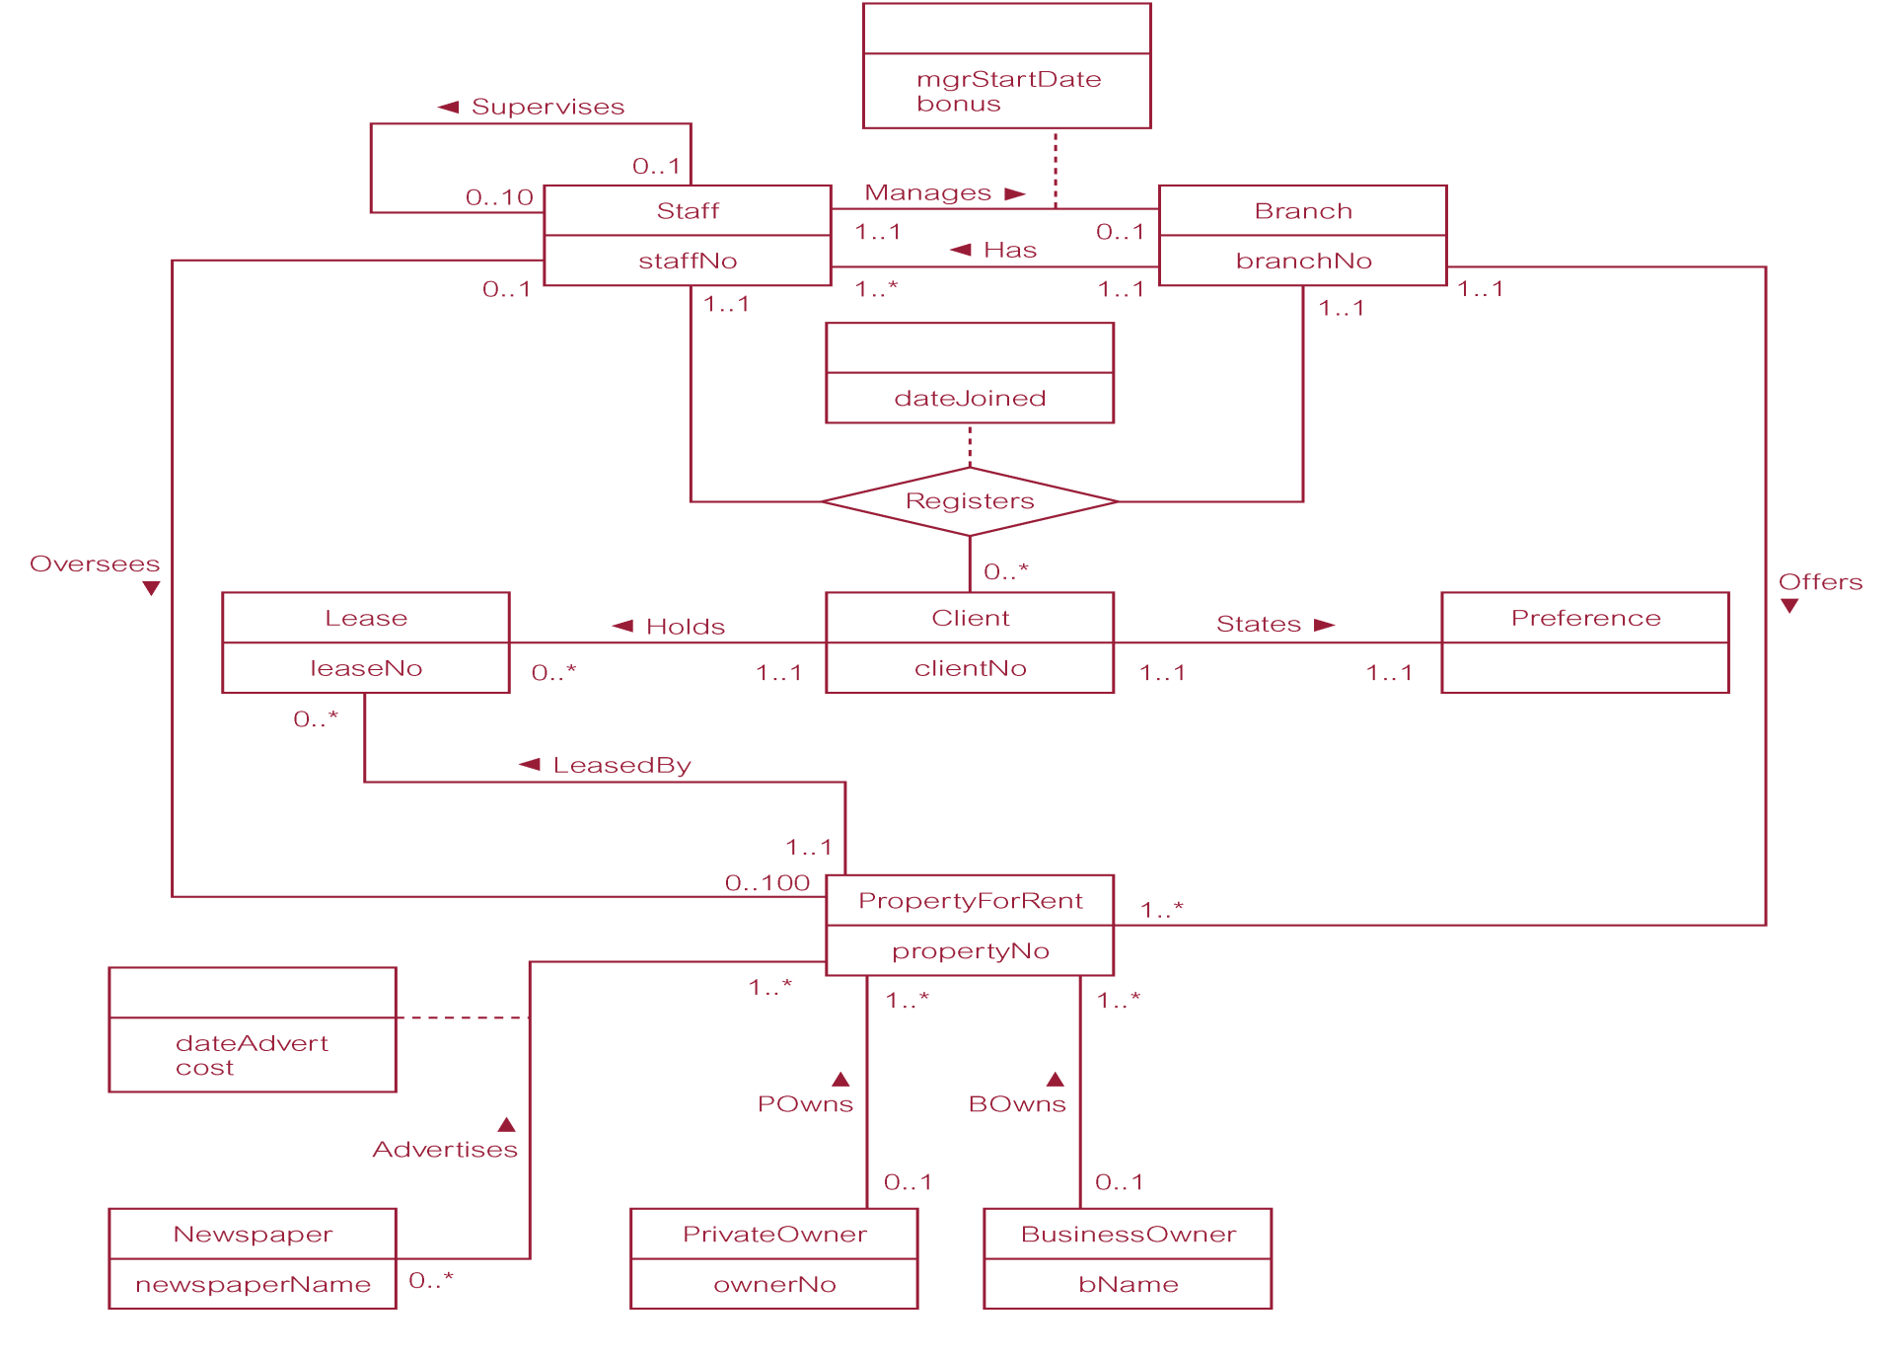
DreamHome Conceptual ERD (Branch View with PKs)

Slide 14
Enhanced Entity-Relationship Modelling
Limitations of basic concepts of ER Modelling
Not sufficient to represent requirements of newer & more complex applications.
Enhanced Entity-Relationship modelling
Borrowed from UML.
Additional semantic modelling concepts incorporated into original ER model.
Output:
EERD (Enhanced Entity Relationship Diagram)
= ERD (Entity Relationship Diagram) + additional semantic concepts
New Semantic concepts
Specialisation.
Generalisation.

Slide 15
Specialisation / Generalisation (1)
Specialisation
Breaking down of an entity into several sub-types (Specialised Entities).
Maximisation of the differences between members of an entity.
Identification of their distinguishing characteristics.
Generalisation
Grouping several entities into one super-type (General Entity).
Minimisation of the differences between members of an entity.
Identification of their common characteristics.

Slide 16
Specialisation / Generalisation (2)
General Entity (aka superclass in UML)
An entity that includes one or more distinct subgroupings of its occurrences.
Specialised Entity (aka subclass in UML)
A distinct subgrouping of occurrences of an entity.
Important considerations
Relationship between a General Entity and a Specialised Entity is one-to-one.
Generalised Entity may be broken down into overlapping or distinct Specialised Entities.
Not all members of a Specialised Entity need to be a member of a General Entity.

Slide 17
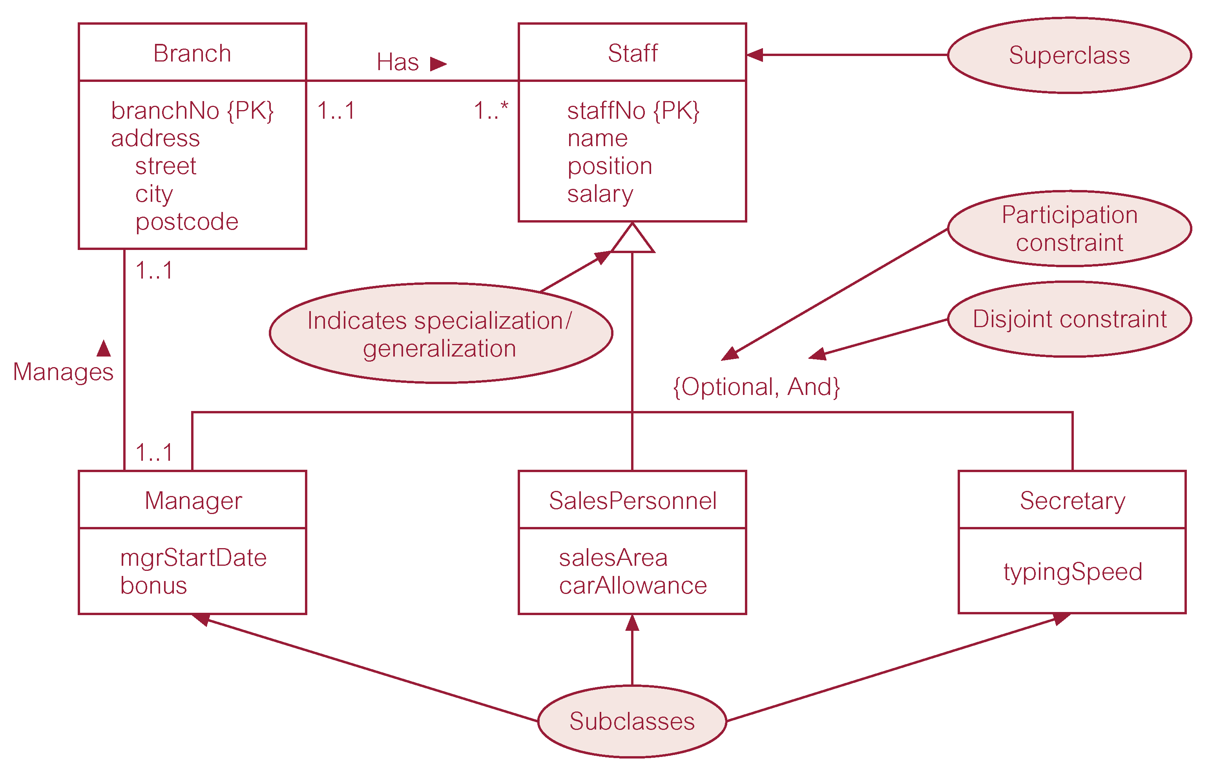
EERD with Specialisation / Generalisation

Slide 18
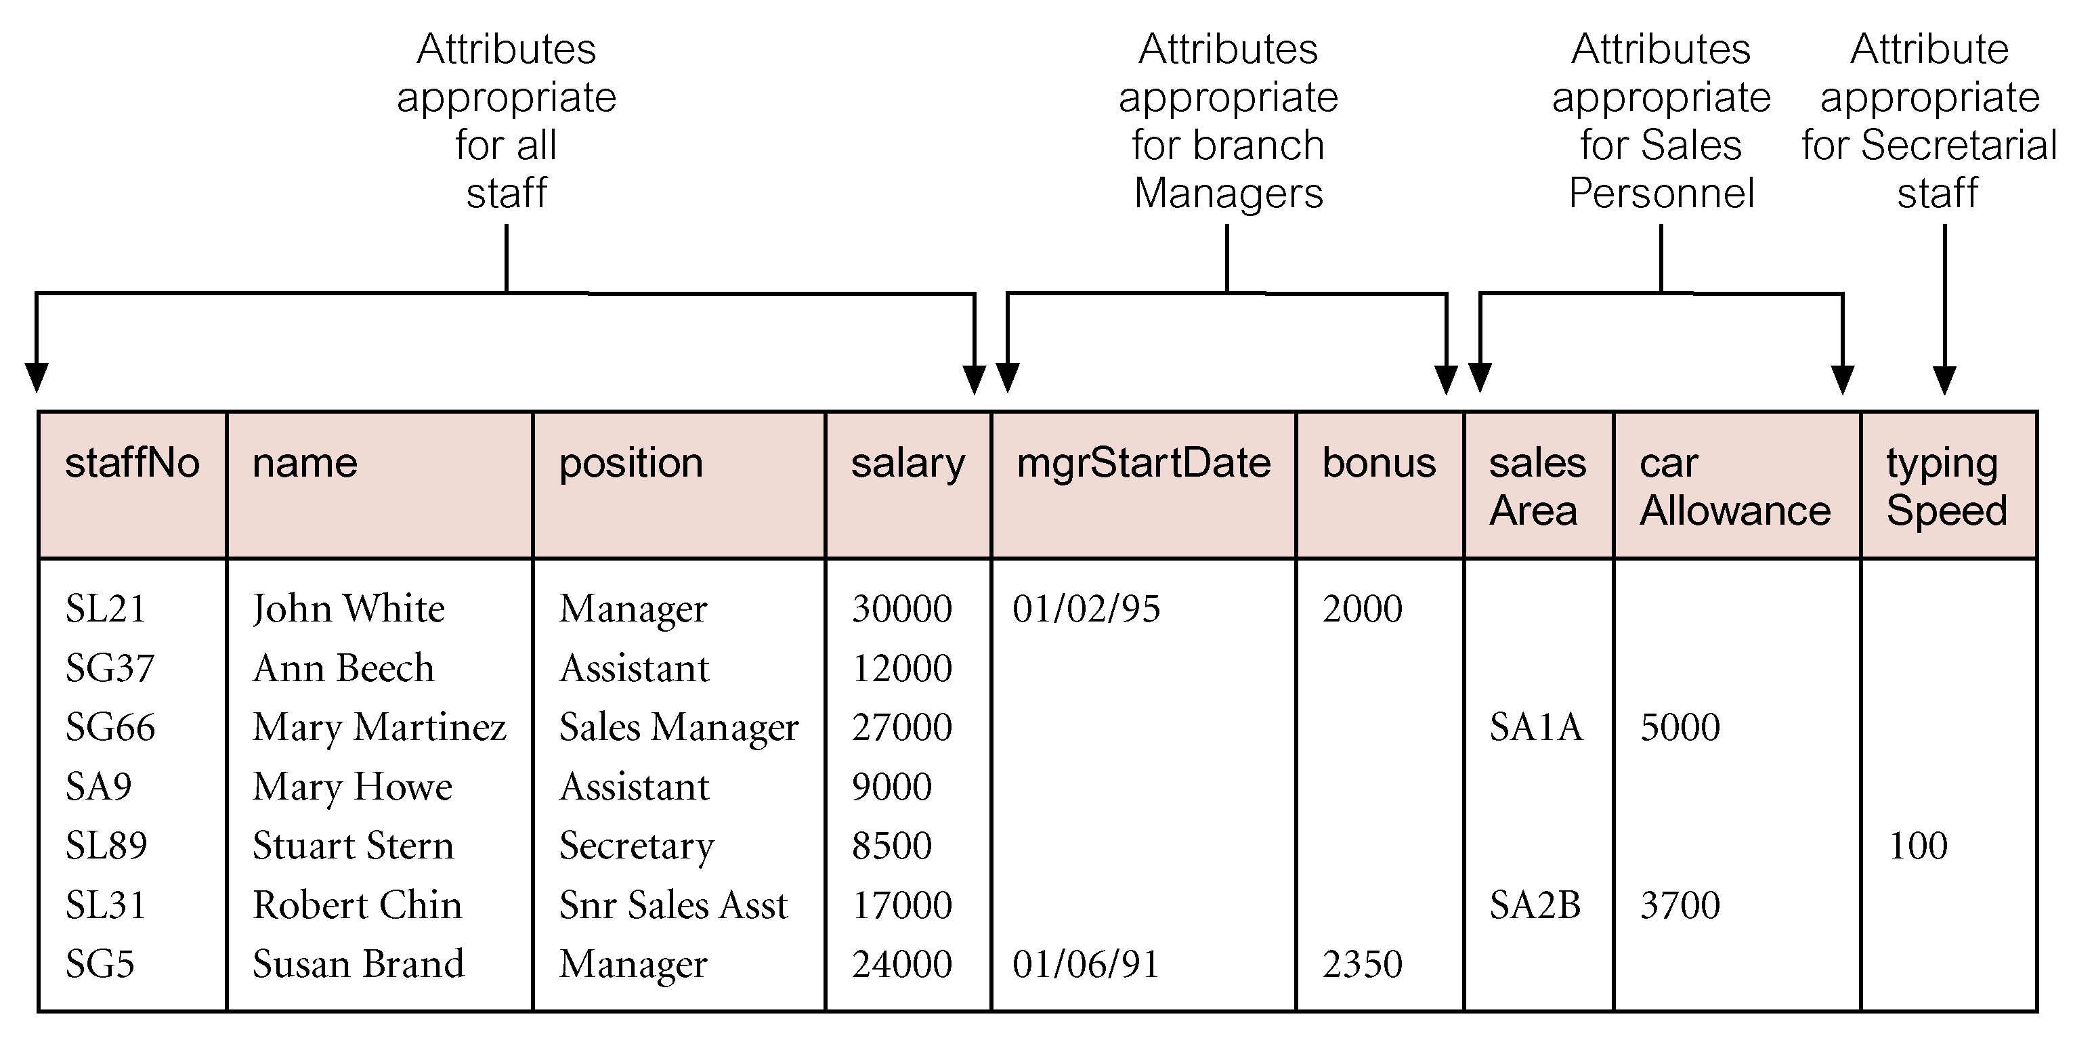
Attribute Inheritance
Attribute inheritance
All the attributes of the General Entity also apply to the Specialised Entity.
In addition, the Specialised Entity may also have its own specific attributes.

Slide 19
Relationship Inheritance
Relationship inheritance
All the relationships of the General Entity also apply to the Specialised Entity.
In addition, the Specialised Entity may also have its own specific relationships.
Department
has
Staff
Lab
1..1
0..*
0..*
{optional, or}
oversees
Module
teaches
Academic
Technician
0..*
0..*
1..1

Slide 20
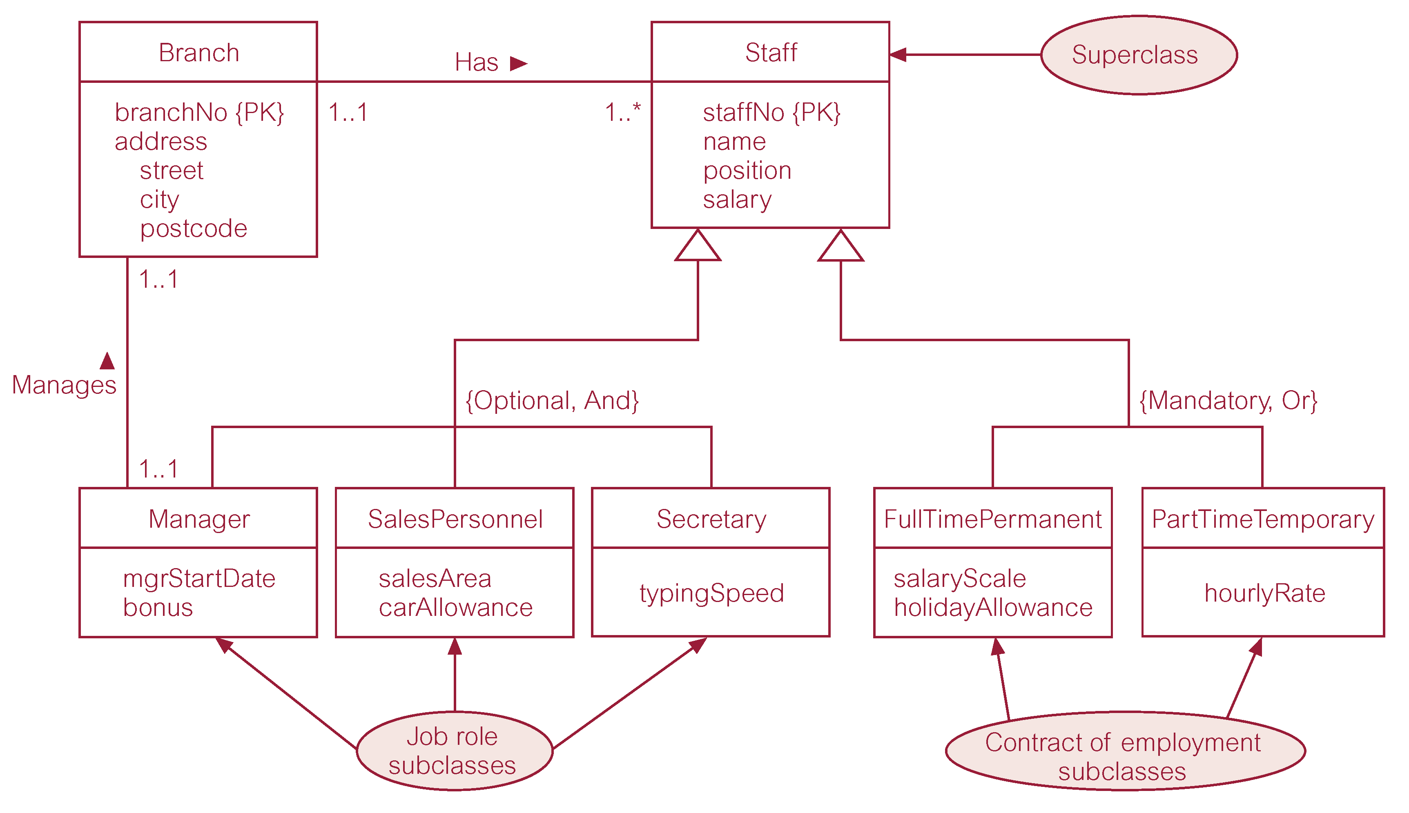
EERD with 2 separate Specialisations / Generalisations

Slide 21
Constraints on Specialisations / Generalisations
Participation Constraint
Describes the connection between members of the General Entity and the Specialised entities.
Determines whether every member in General Entity must participate as a member of a Specialised Entity or whether a member of the General Entity can be something else not represented through the Specialisation.
May be “Mandatory” or “Optional”.
Disjoint Constraint
Describes the connection between members of the Specialised Entities.
Indicates whether a member of a Specialised Entity can also be a member of one, or more, of the other Specialised Entities.
May be Disjoint or Non-Disjoint
Is written as “Or” or “And”.

Slide 22
Four Constraints on Specialisations / Generalisations
{Mandatory, Or}
Mandatory: mandatory participation in specialisation.
Disjoint: no overlap between members of Specialised Entities.
{Mandatory, And}
Mandatory: mandatory participation in specialisation.
Non-Disjoint: overlap between members of Specialised Entities is possible.
{Optional, Or}
Optional: optional participation in specialisation.
Disjoint: no overlap between members of Specialised Entities.
{Optional, And}
Optional: optional participation in specialisation.
Non-Disjoint: overlap between members of Specialised Entities is possible.

Slide 23
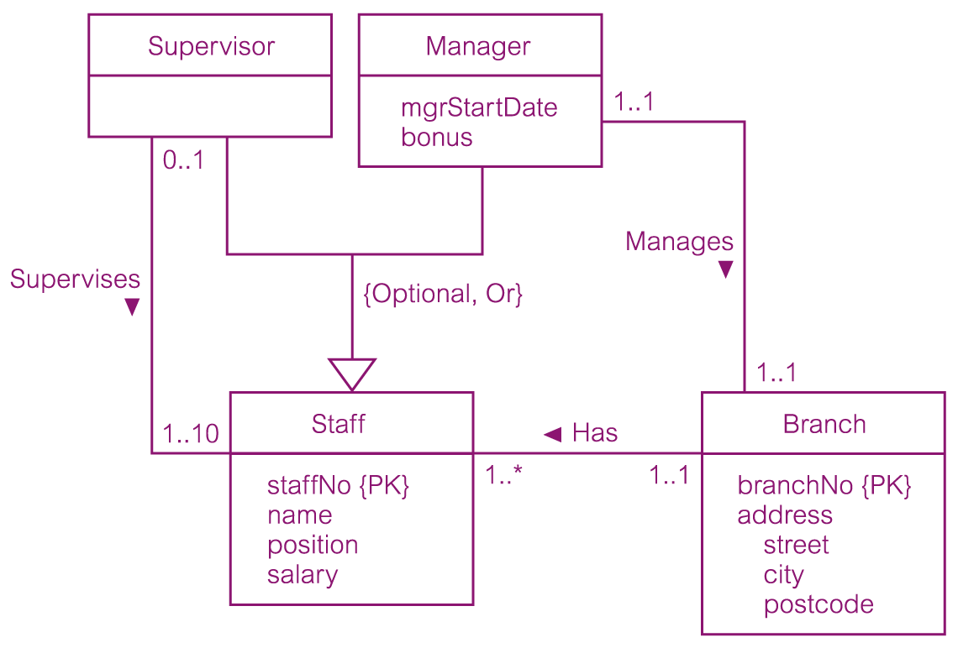
{Optional, Or} Constraint

Slide 24
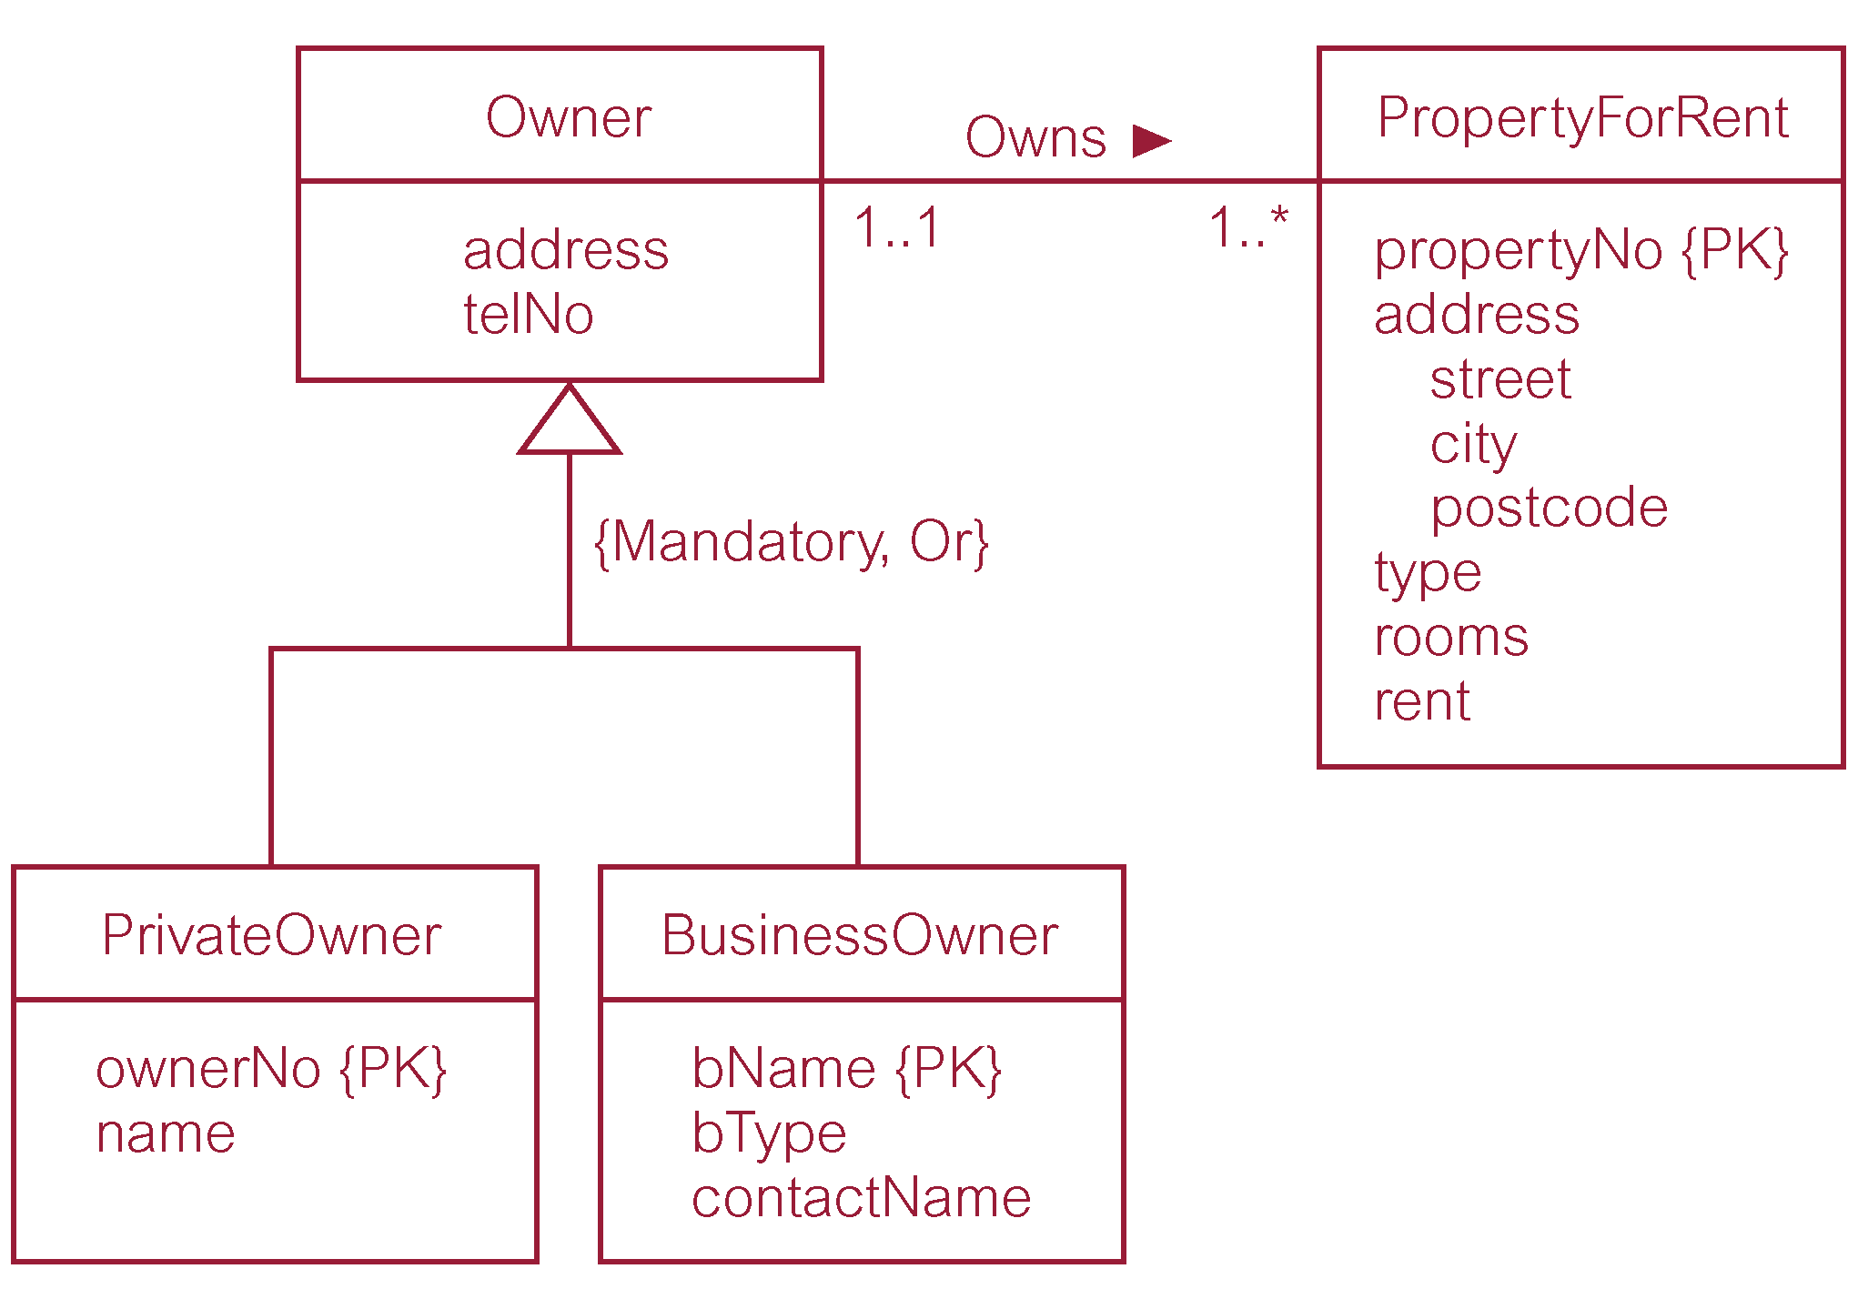
{Mandatory, Or} Constraint

Slide 25
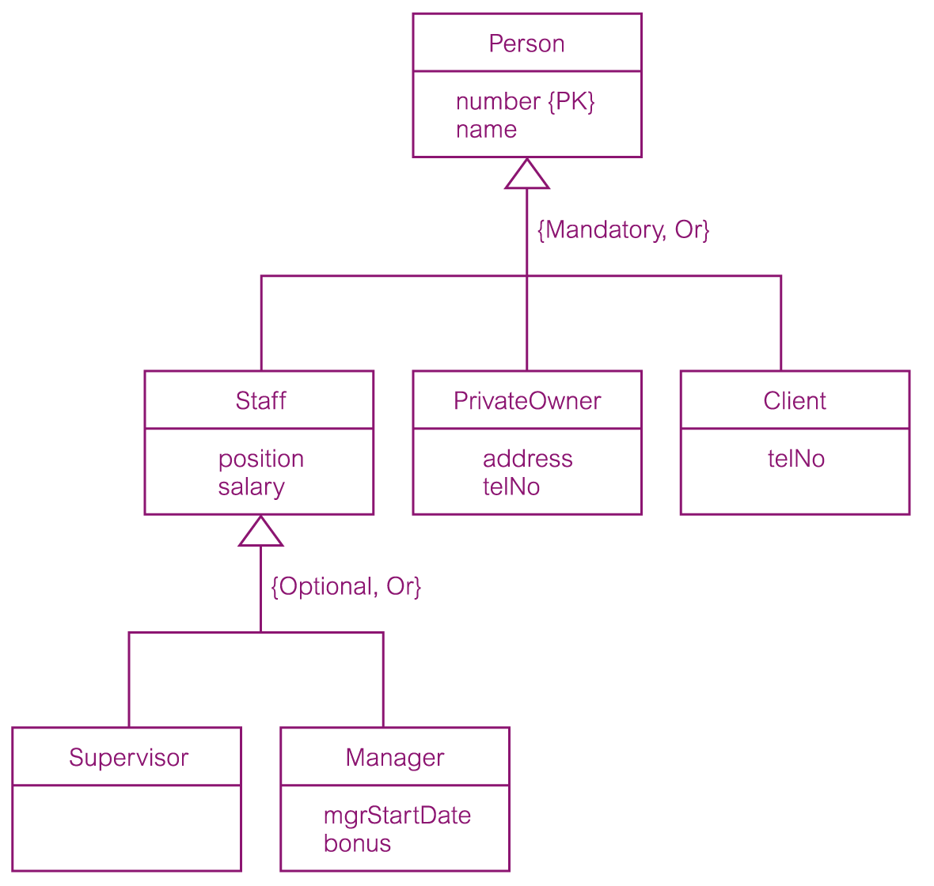
{Mandatory, Or} and {Optional, Or} Constraint

Slide 26
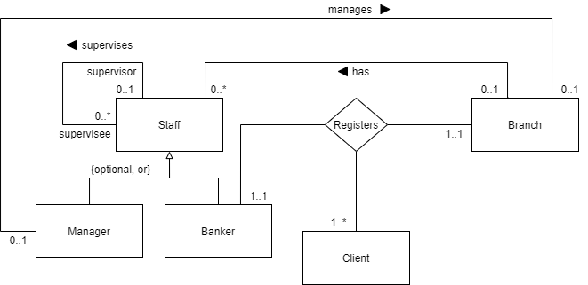
Another example of an EERD: the Bank

Slide 27
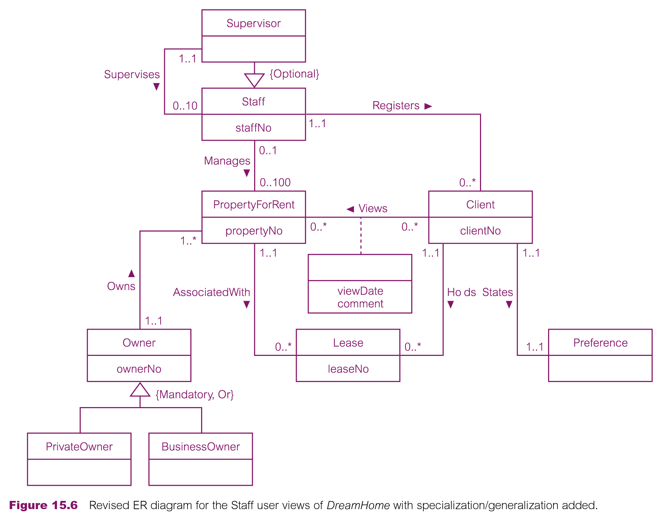
DreamHome Conceptual EERD (Staff View with Specialisations)

Slide 28
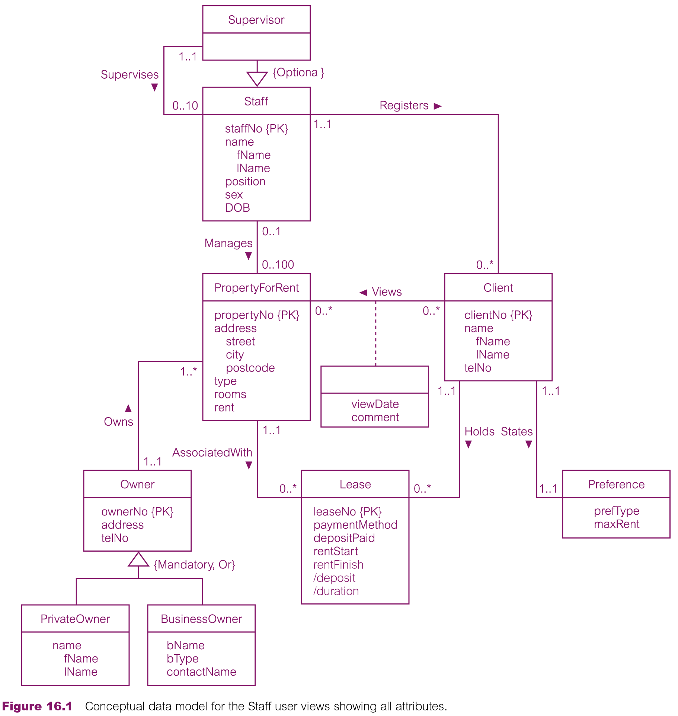
DreamHome Conceptual EERD (Staff View with Specialisations & Attributes)

Slide 29
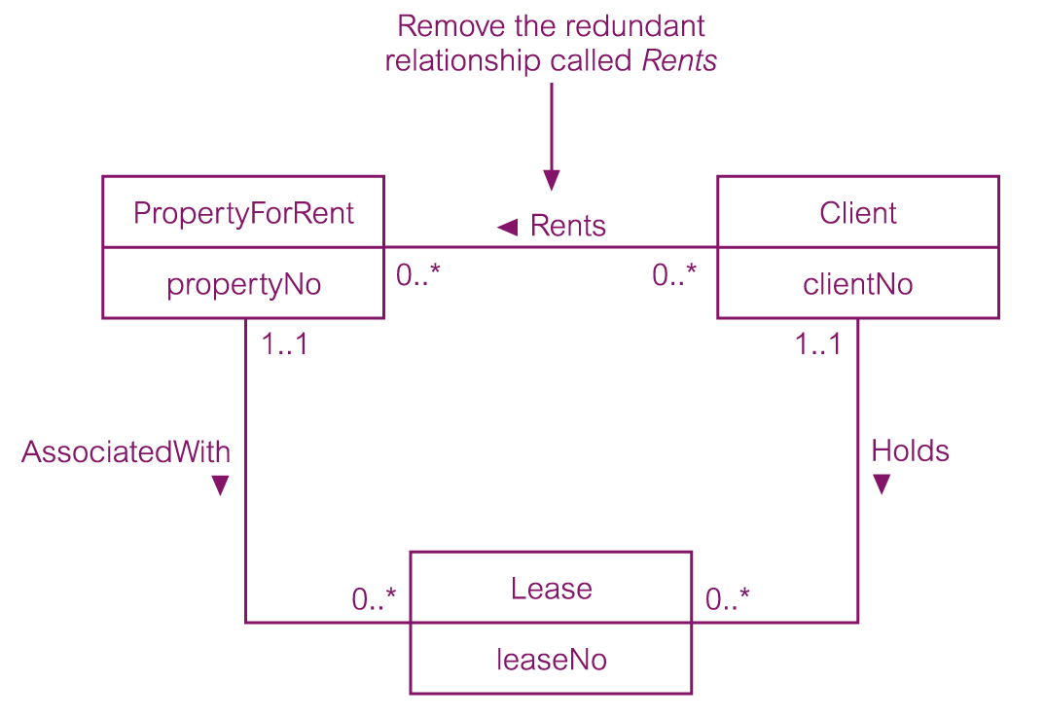
Redundant relationship: remove!

Slide 30
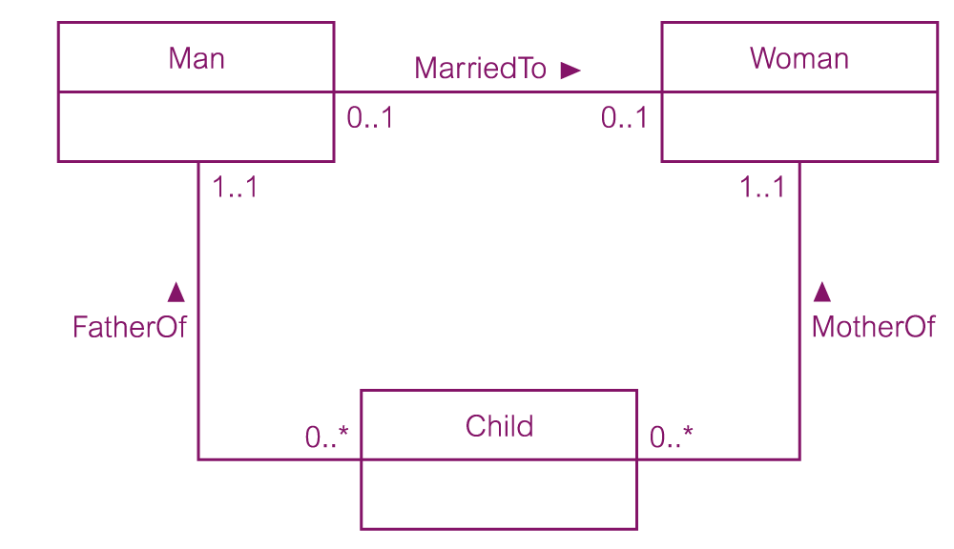
Non-redundant relationship: do not remove!

Slide 31
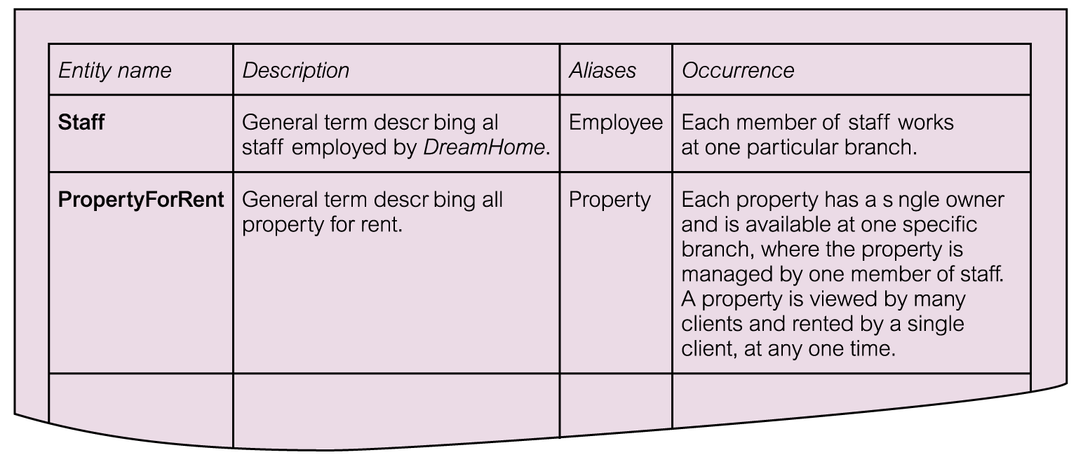
Data Dictionary: description of entities

Slide 32
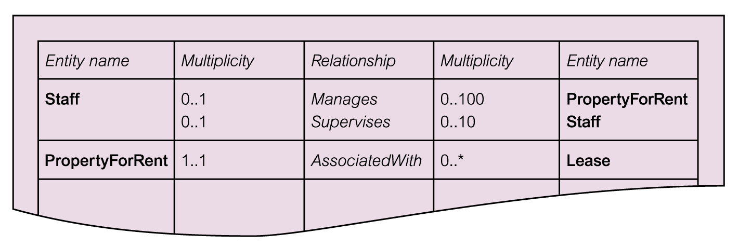
Data Dictionary: description of relationships & multiplicities

Slide 33
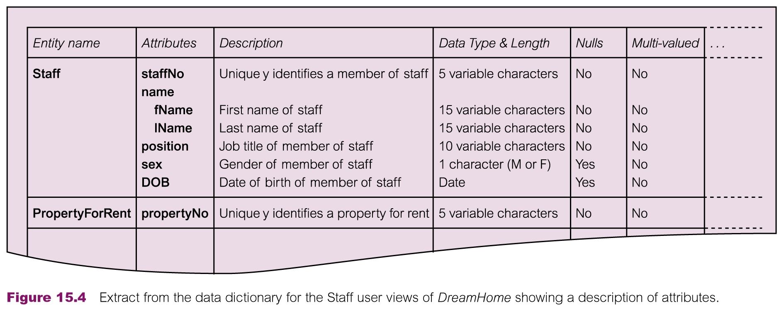
Data Dictionary: description of attributes

Slide 34
References and Essential Readings
Module Reading List: https://rl.talis.com/3/westminster/lists/2CAA7D6B-DCAD-AB71-C97B-7FEFCB499C28.html
Connolly, T. & Begg, C. E. (2015). Database systems: a practical approach to design, implementation and management. 6th Edition (Global Edition). Pearson Education. Ch. 1, 12, 13, 16.
Elmasri, R. & Navathe, S. (2017). Fundamentals of Database Systems. 7th Edition (Global Edition). Pearson Education. Ch. 1, 2, 4.

